Slide 1

HCHD Board Report
Presented by: Senior Leadership Team
February 24, 2022

Slide 2


Human Resources Update
February 24, 2022
SPEET

Slide 3
Employee Engagement
SPRHC Employee Engagement Survey 2021
Nov 01, 2021 - Dec 22, 2021
Reporting Group: All - All
Copyright 2022 Gallup, Inc. All rights reserved. Copyright © 1993-1998 Gallup, Inc. All rights reserved. The Gallup Q12 items are Gallup proprietary information and are protected by law. You may not administer a survey with the Q12 items or reproduce them without consent from Gallup.
GALLUP

Slide 4
Q¹² Mean
The Gallup Q¹² score represents the average, combined score of the 12 elements that measure employee engagement. Each element has consistently been linked to better business outcomes.
TOTAL RESPONDENTS
ENGAGEMENT MEAN
ENGAGEMENT INDEX
140
3.64
MEAN PERCENTILE RANK
20
Database: Gallup Overall
*All text analytics are machine generated. Because we use machine learning to generate sentiments, results may not be 100% accurate.
*Percent Engaged available when n ≥ 30. All categories available when n ≥ 100.
* - Scores are not available due to data suppression. Respondents can select multiple responses for multi-select questions.
Percentile Rank in Gallup Overall Database
< 25th Percentile
25-49th Percentile
50-74th Percentile
75-89th Percentile
>= 90th Percentile
2
Copyright 2022 Gallup, Inc. All rights reserved. Copyright © 1993-1998 Gallup, Inc. All rights reserved. The Gallup Q12 items are Gallup proprietary information and are protected by law. You may not administer a survey with the Q12 items or reproduce them without consent from Gallup.
GALLUP

Slide 5
Engagement Index
There is a powerful link between employees who are engaged in their jobs and the achievement of crucial business outcomes.
ENGAGEMENT INDEX RATIO
Engaged
1.48
Employees are highly involved in and enthusiastic about their work and workplace. They are psychological "owners", drive performance, innovation, and move the organization forward.
ENGAGEMENT INDEX
Not Engaged
Employees are essentially psychologically unattached to their work and company. Because their engagement needs are not being fully met, they’re putting time – but not energy or passion – into their work.
Actively Disengaged
Employees aren’t just unhappy at work – they are resentful that their needs are not being met and are busy acting out their unhappiness. Every day, these workers potentially undermine what their engaged coworkers accomplish.
*Percent Engaged available when n ≥ 30. All categories available when n ≥ 100.
* - Scores are not available due to data suppression. Respondents can select multiple responses for multi-select questions.
8
Copyright 2022 Gallup, Inc. All rights reserved. Copyright © 1993-1998 Gallup, Inc. All rights reserved. The Gallup Q12 items are Gallup proprietary information and are protected by law. You may not administer a survey with the Q12 items or reproduce them without consent from Gallup.
GALLUP

Slide 6
Gallup Q¹² Items
Mean Percentile Rank - Gallup Overall
Company Overall Current Mean
Questions
Total N
Current Mean
Q00: Overall Satisfaction
138
3.62
19
3.62
Q01: Know What's Expected
140
4.46
45
4.46
Q02: Materials and Equipment
139
3.76
23
3.76
Q03: Opportunity to do Best
139
4.07
42
4.07
Q04: Recognition
134
3.11
20
3.11
Q05: Cares About Me
135
3.96
29
3.96
Q06: Development
136
3.71
30
3.71
Q07: Opinions Count
137
3.36
20
3.36
Q08: Mission/Purpose
139
3.91
32
3.91
Q09: Committed to Quality
139
3.67
18
3.67
Q10: Best Friend
121
2.99
17
2.99
Q11: Progress
133
3.22
15
3.22
Q12: Learn and Grow
129
3.48
15
3.48
*Not shown if n < 4 for Mean, Top Box, Verbatim Responses, and Sentiment, n < 10 for Frequency, or data is unavailable.
* - Scores are not available due to data suppression. Respondents can select multiple responses for multi-select questions.
Percentile Rank in Gallup Overall Database
< 25th Percentile
25-49th Percentile
50-74th Percentile
75-89th Percentile
>= 90th Percentile
3
Copyright 2022 Gallup, Inc. All rights reserved. Copyright © 1993-1998 Gallup, Inc. All rights reserved. The Gallup Q12 items are Gallup proprietary information and are protected by law. You may not administer a survey with the Q12 items or reproduce them without consent from Gallup.
GALLUP

Slide 7


CDHS Report
Prepared for the HCH District Board
01/27/2022

Slide 8
CEO REPORT
Kay Whitley

Slide 9
Updates
Staffing Challenges:
  We are working with Employers Council to provide an updated market comparison for all staff.
  Covid Unit pay
Anesthesia/Pain Management
  Dr. Keith Nichols
Rural Conferences:
  CHRC conference April 6-8th Renaissance Denver Central Park Hotel

Slide 10

Updates
Current projects underway:
  Meditech Expanse – GO LIVE 3/1
  Retail Pharmacy
  VCLC and Lobby remodel
  Kansas Bld. (offer accepted)
Vaccine clinic
  Scheduled every Friday at the RHC
  Booster shots for employees are also available through our Employee Health office
    We are still encouraging boosters!

Slide 11
Local COVID Updates (Feb. 16-22nd)
January Board Meeting
Las Animas County – 3,281 Total Cumulative Cases
139 New Reported Cases
493 Active Cases
37 Deaths Due to COVID-19
Huerfano County- 1,344 Total Cumulative Cases
116 New reported Cases
255 Active Cases
28 Deaths Due to COVID-19
Current
Las Animas County – 3,656 Total Cumulative Cases
46 New Reported Cases
90 Active Cases
39 Deaths Due to COVID-19
Huerfano County- 1,566 Total Cumulative Cases
18 New reported Cases
51 Active Cases
29 Deaths Due to COVID-19

Slide 12
ANHA REPORT
Teresa Clift

Slide 13

NH Update
Census 69 as of 2/23/2022
Admissions update
  3 new admissions since January 1, 2022 ( pending)
Remain in Outbreak
  2 residents currently in COVID Unit
  Last round of testing negative – one more round to close outbreak

Slide 14

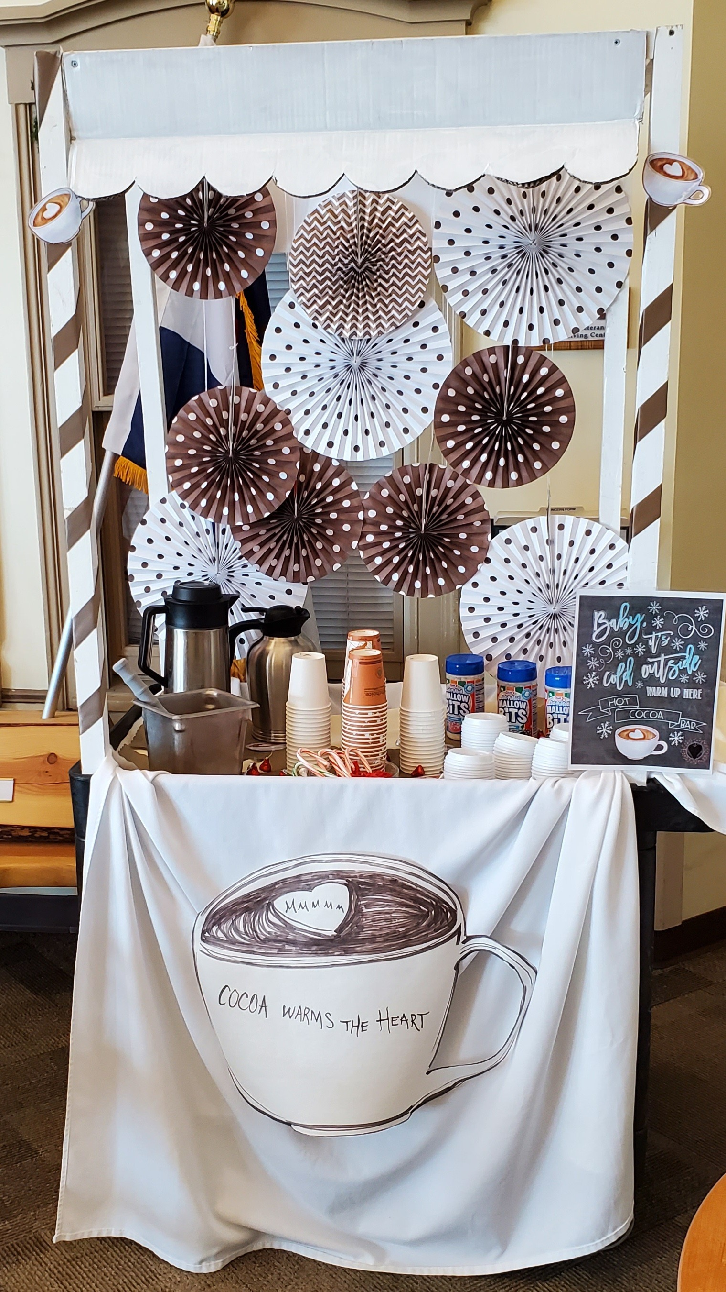
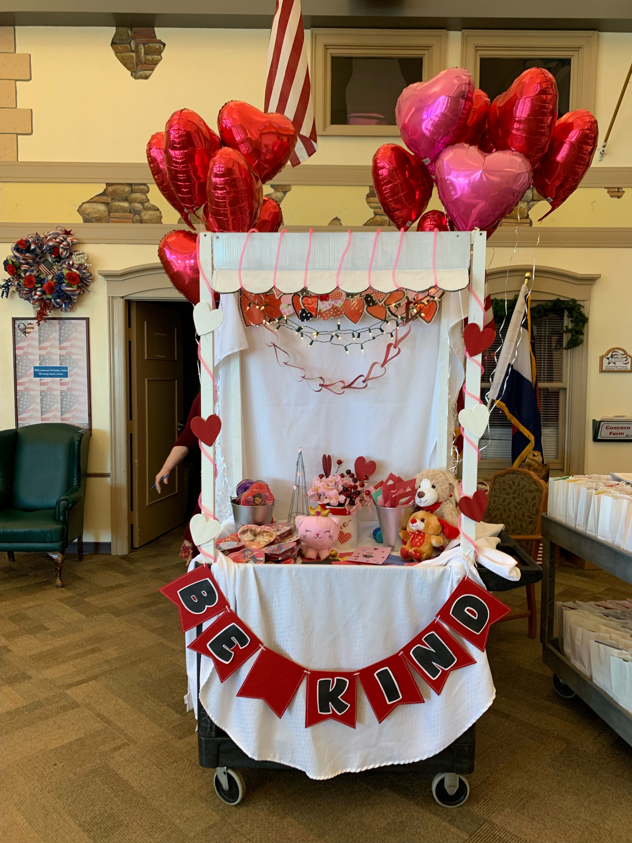
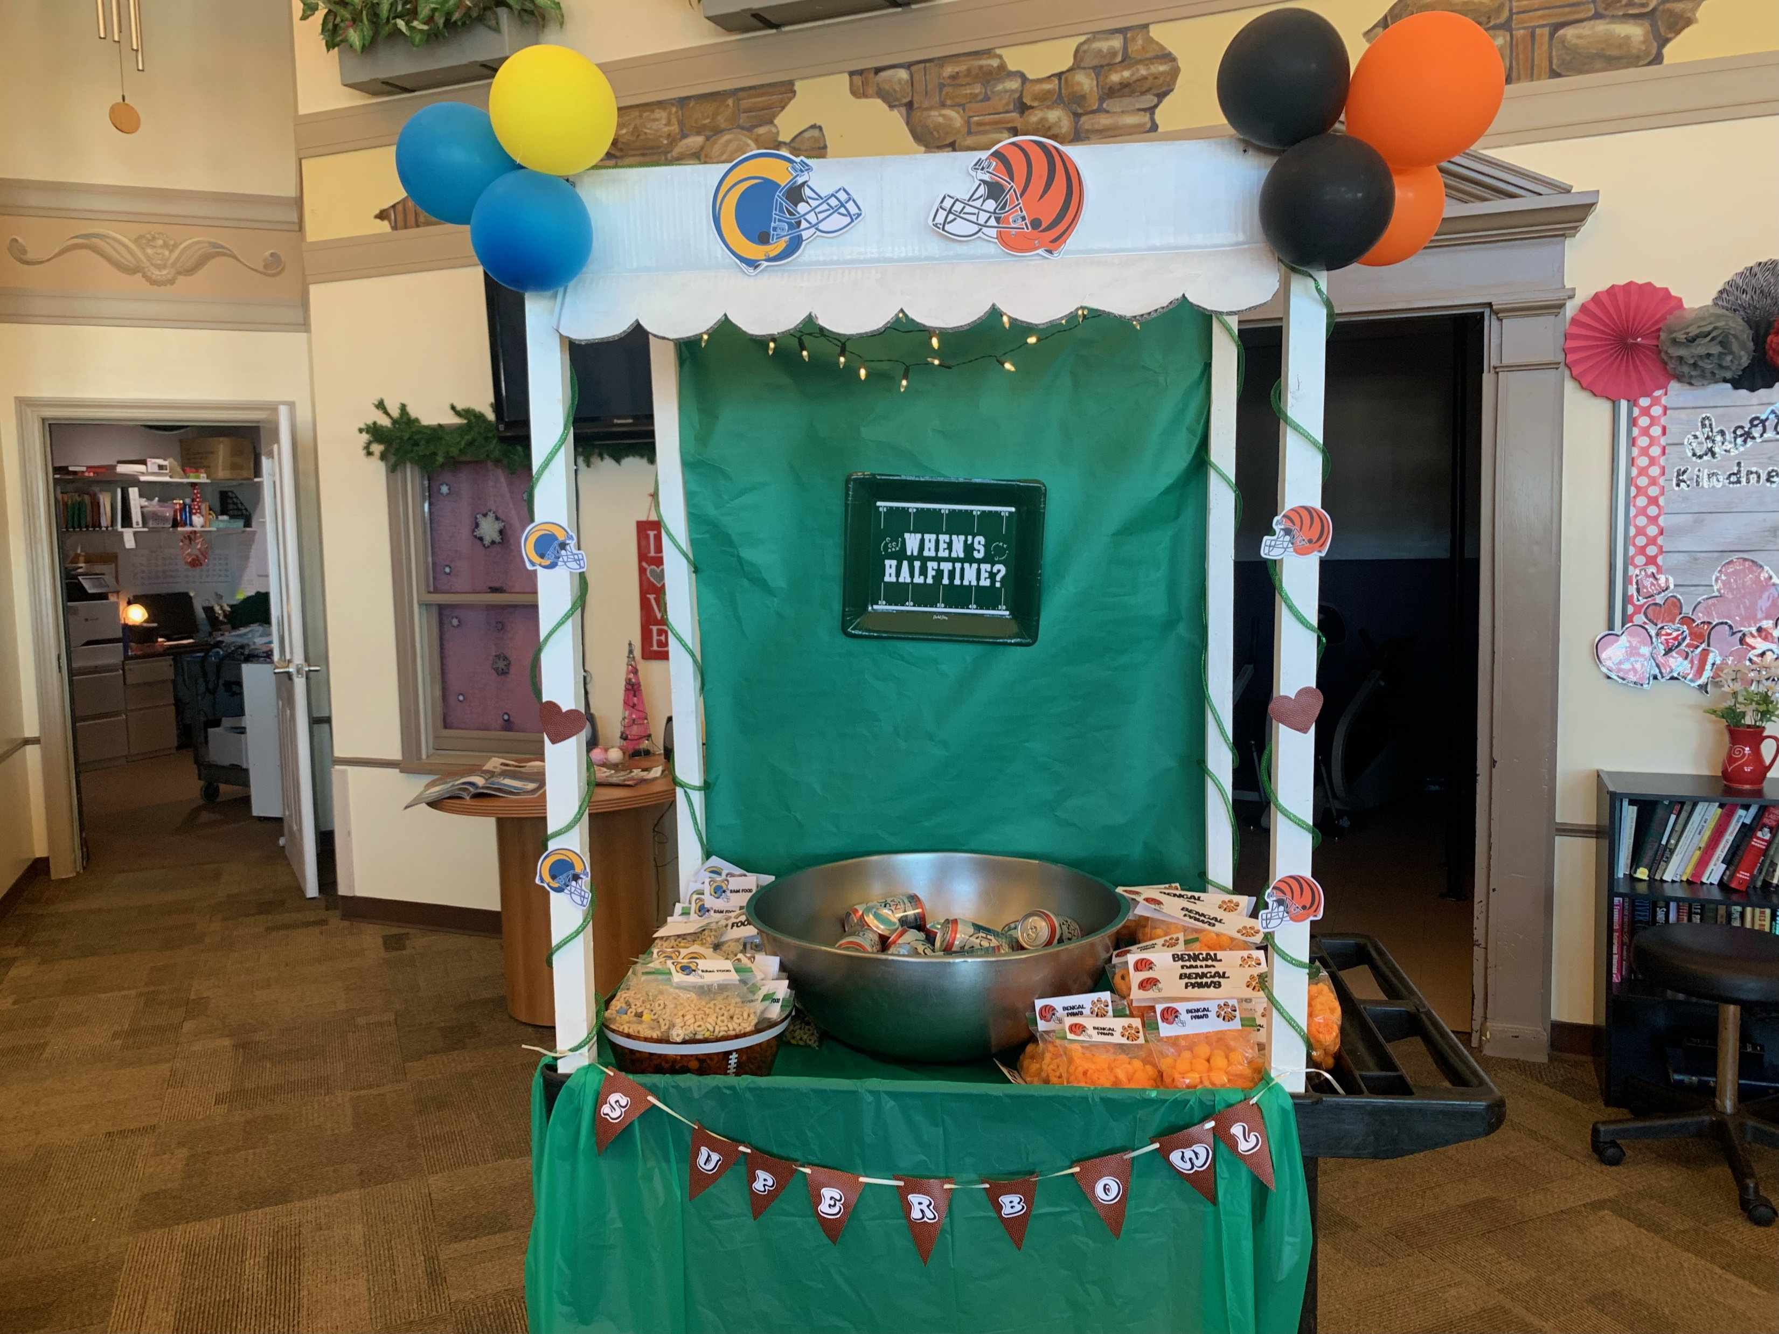
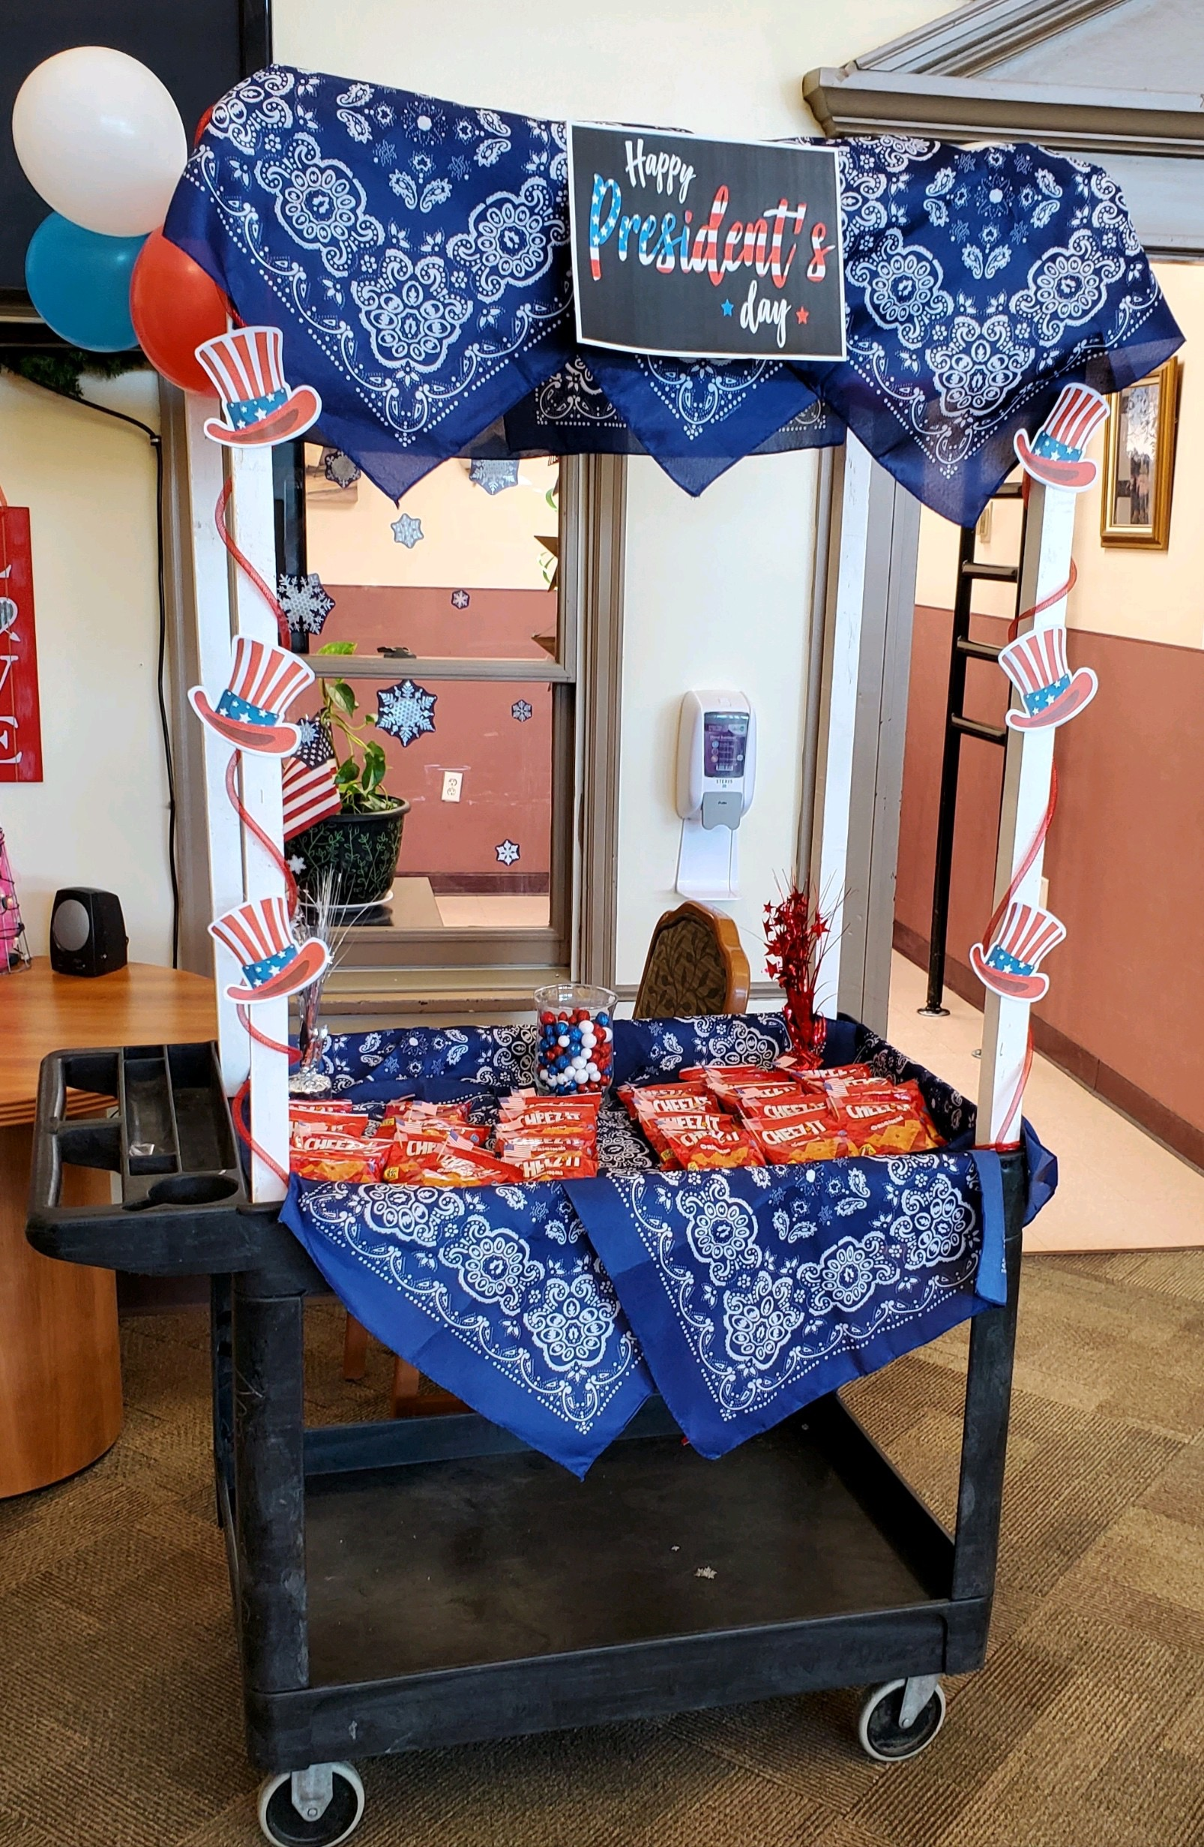
Activities Cart

Slide 15
CNO REPORT
Kelea Nardini, MSN, RN

Slide 16
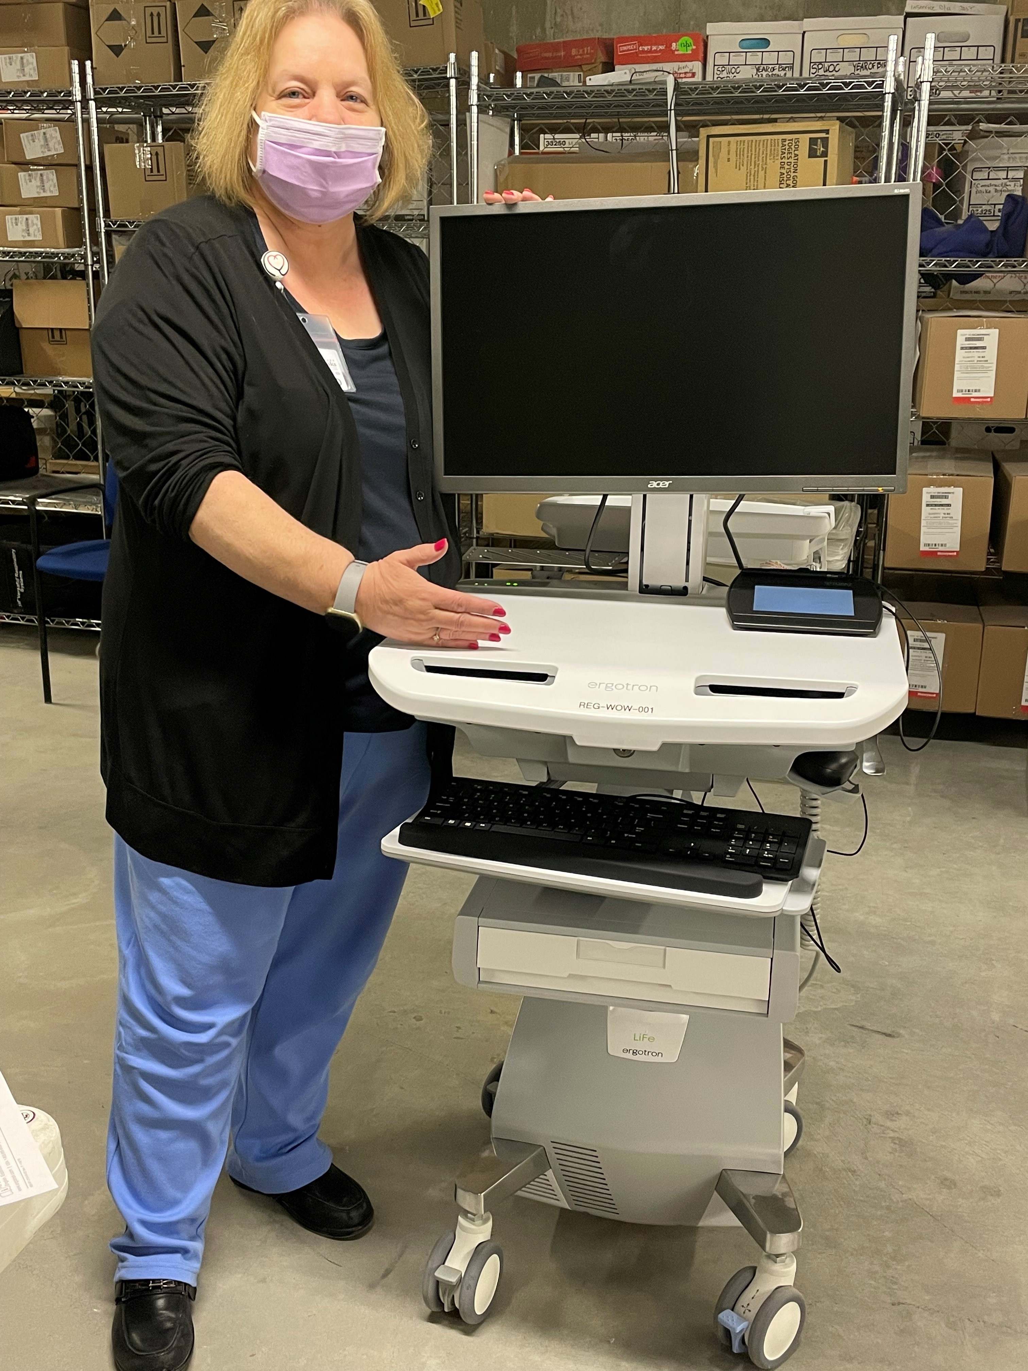
CNO Update
Clinics
Acute/ECU/ED
Lab
RT
Radiology
EMS
Pharmacy
Surgical Services
Infection/Employee Health
MEDITECH GO-LIVE

Slide 17
CFO/COO REPORT
Colette Martin

Slide 18
CFO/COO Activities
IT
  Expanse
  Q1 Projects (examples)
    Cyber Security
    Remote Access
Finance Team
  Audit Work in Process
Materials Management
  Primary Vendor Conversion from Cardinal to Medline

Slide 19
Meditech Expanse
✓September 15-16: Kick Off
✓ December 13 – 16: Integrated Testing
✓ January 11 – 13: Mock LIVE
  Successful – compliments from Meditech regarding staff preparedness
  Interface issues but work underway
February 14 – 18: LIVE Copy
March 1: GO LIVE
Technology Investments
  Computers
  WOWs
  Point of Care Devices
  E Faxing
  Electronic Forms
  Digital Signature Pads

Slide 20
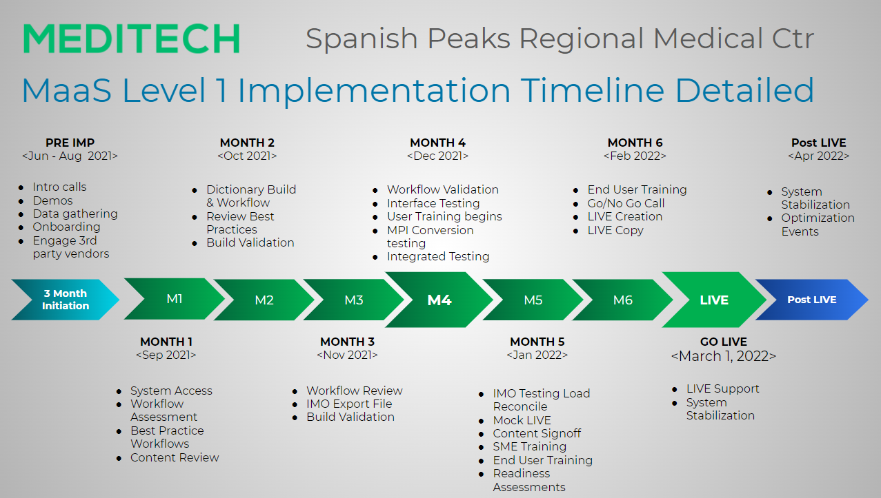

Slide 21
FINANCIAL REPORT
Lola Spradley, treasurer

Slide 22
Financial Statements Summary

Slide 23
Volumes Trending

Slide 24
Volumes Trending

Slide 25
Volumes Trending

Slide 26
Volumes Trending

Slide 27
PLC UPDATE
Lola Spradley

Slide 28
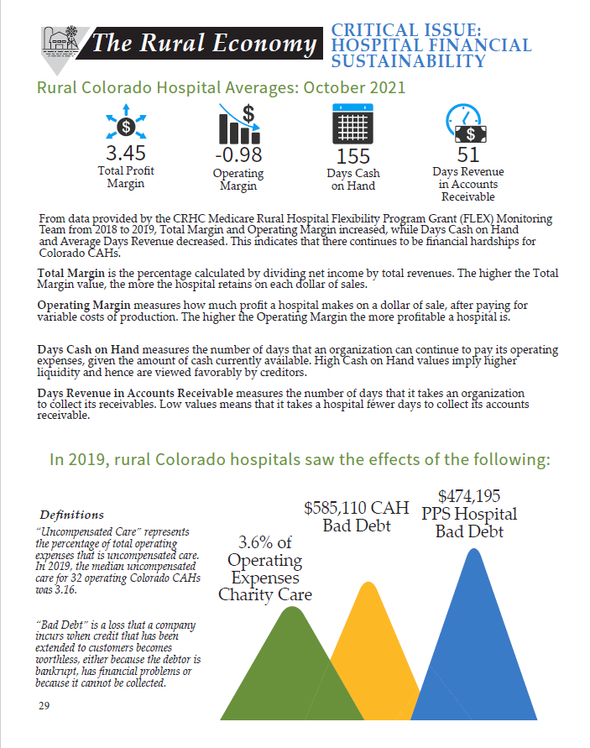

Slide 33
Quality Update
Dr. John Davis

